Slide 1
Capstone ETL Process Manager
by Kenneth Copas

Slide 2

:)
Professional Summary
Before Apprenticeship
Software Engineering (JavaScript, HTML, CSS, Java, Python)
Object-Oriented Programming, Dynamic Programming
During Apprenticeship
After Apprenticeship
Courses and Certifications
Data Engineering processes
Database Management, Data Analysis & Visualization
Learned Agile Methodology
Developing skillsets related to Data Engineering (Database Management, Data Processing)
Kenny Copas
Jr. Data Engineer
PeopleShores PBC
Tampa, FL
linkedin.com/in/kennycopas

Slide 3





Tech Stack Overview
Database | Data Processing | Application | Visualization

Slide 4
Project Overview Functional Requirements
ETL Pipeline
- Extract
- Transform
- Load
Command Line Interface
- User-friendly
- Data Querying
Analysis & Visualization
- Tell a Story
- Support Claims

Slide 5
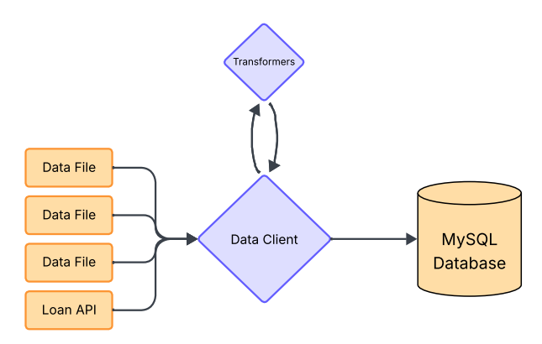
ETL Pipeline
Data Client
Manages ETL Process
Handles Database Queries
Transformers
Contains file-specific transformer functions
Handles transformer mapping

Slide 6
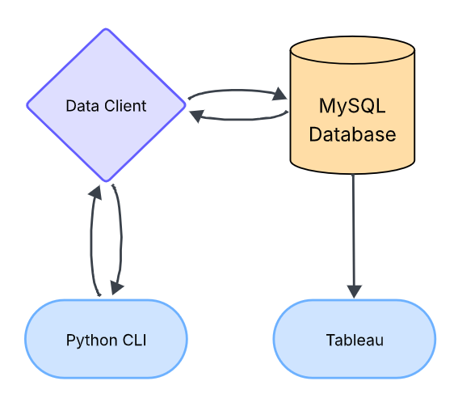
CLI & Tableau
Data Client
Cleans and loads data into MySQL for querying
Handles database query requests from CLI
Python CLI
User-friendly database interaction
Sends database queries to Data Client
Tableau
Data Analysis & Visualization
Sources data from MySQL database

Slide 7
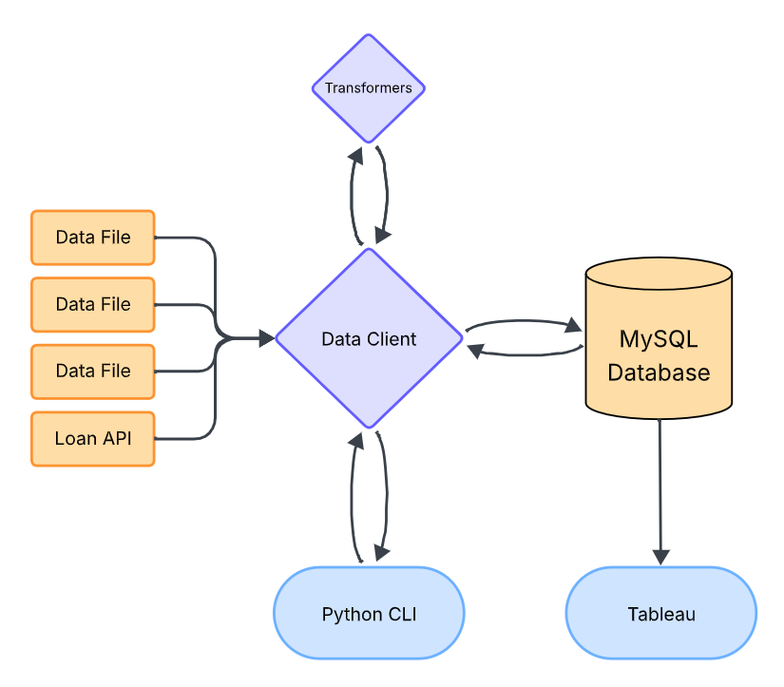
Application Workflow
Central Component
Data Client
Database
MySQL
Frontend
Python CLI & Tableau

Slide 8
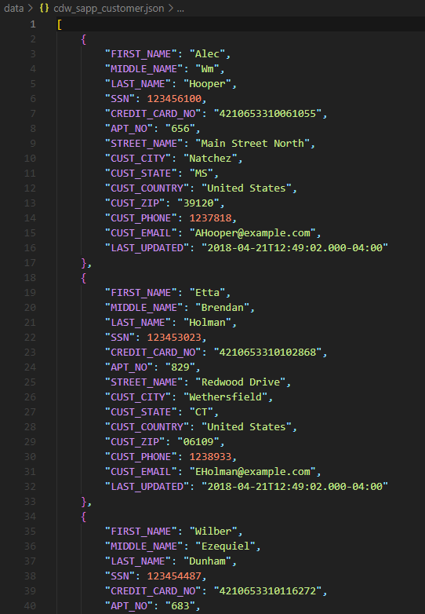
JSON Data
Point A
cdw_sapp_customer.json - Data
Unformatted
Unsorted
Cannot be loaded into database

Slide 9
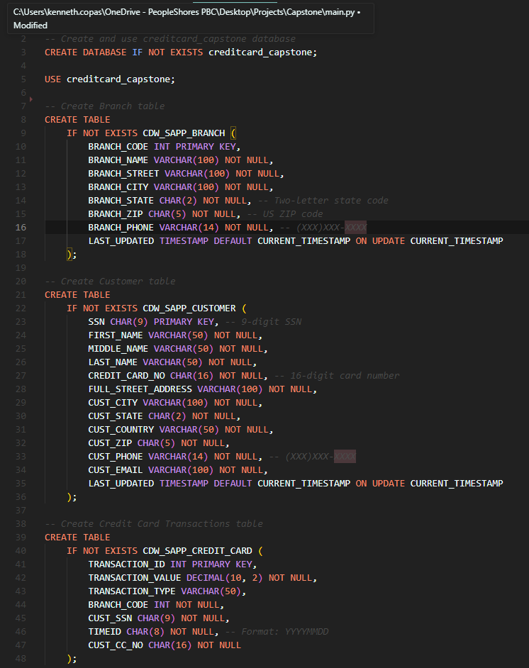
SQL Script
Point B (Database)
init.sql - Script
Initializes Database
Creates Tables

Slide 10
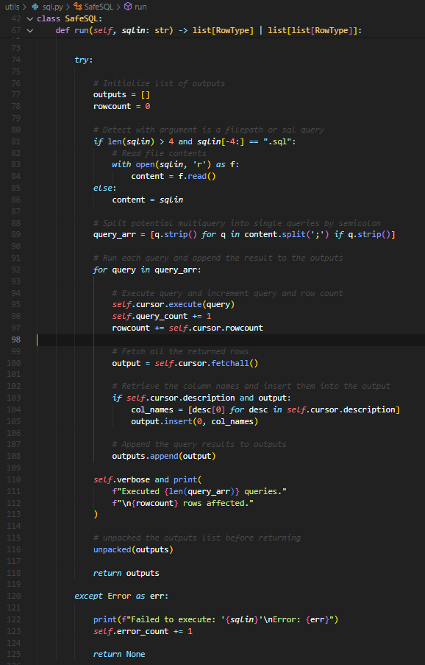
Database Connection
Key
sql.py - Utility
Database Interaction
Error Handling
Modular

Slide 11
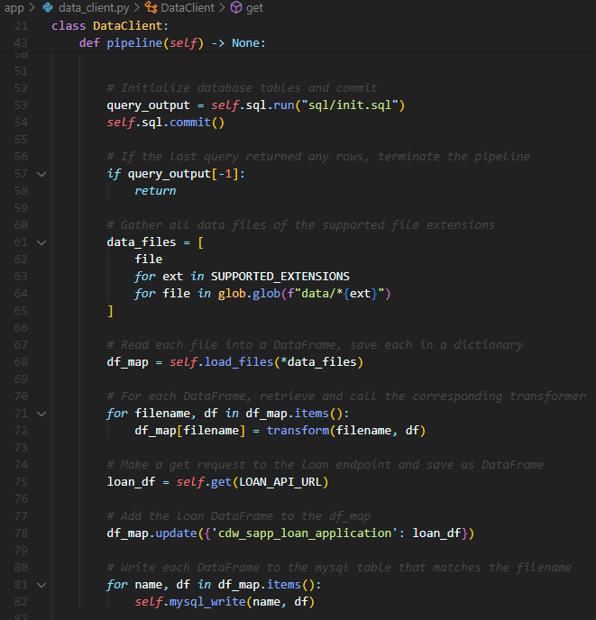
Data Client
Car
data_client.py - Component
Application-Specific
Manages ETL Process
Utilizes MySQL and PySpark connections

Slide 12
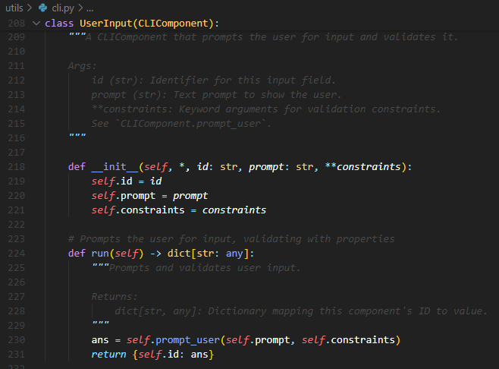
CLI Builder
UI Elements
cli.py - Utility
Components used to build a CLI
General
Modular

Slide 13
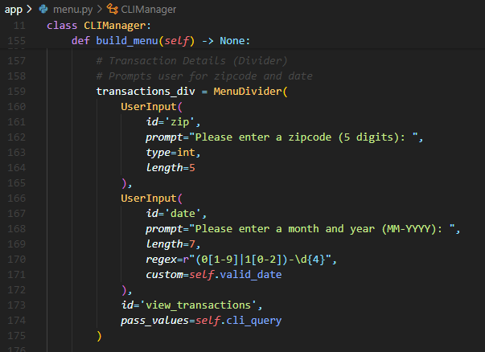
Command Line Interface
Website
menu.py - Component
User-friendly
Intuitive
Natural Language

Slide 14
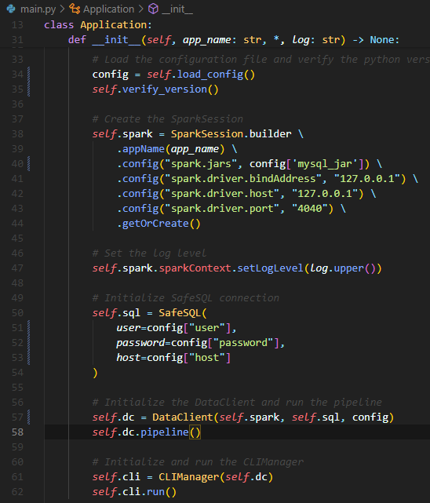
Application
Manager
main.py - Application
Establishes database connections
Manages Data Client and CLI

Slide 15
Project Structure
main.py # Application requirements.txt # Required Libraries app/ ├── data_client.py # Data Client ├── menu.py # CLI Menu Class └── transformers.py # Transformer Functions config/ ├── config.json # PySpark, MySQL Config └── constants.py # Global Constants data/ # JSON files ├── cdw_sapp_branch.json ├── cdw_sapp_credit_card.json └── cdw_sapp_customer.json | lib/ # MySQL Connector JDBC └── mysql-connector-j-9.3.0.jar sql/ # SQL Scripts ├── cli_script.sql └── init.sql utils/ ├── cli.py # CLI Builder Class └── sql.py # MySQL Connector Class docs/ ├── CAP350_Project_Specs.pdf ├── diagrams/ # Workflow Diagrams └── mapping/ # Mapping PDFs

Slide 16
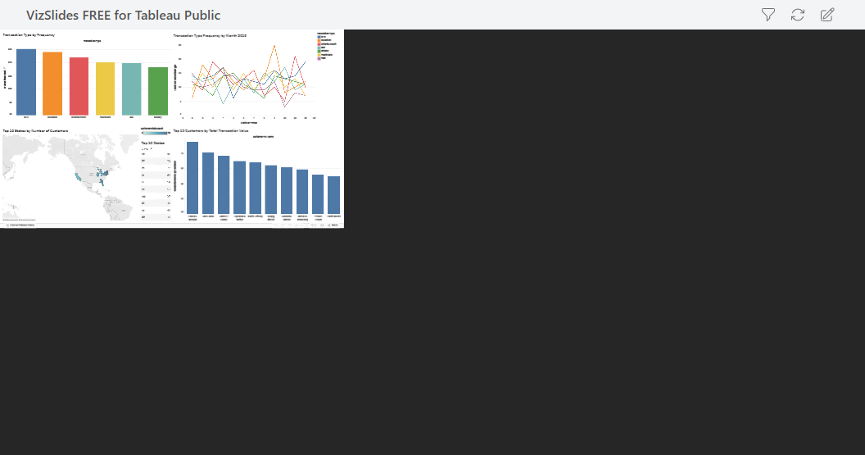
Tableau Visualization

Slide 17
Thanks!

Slide 18
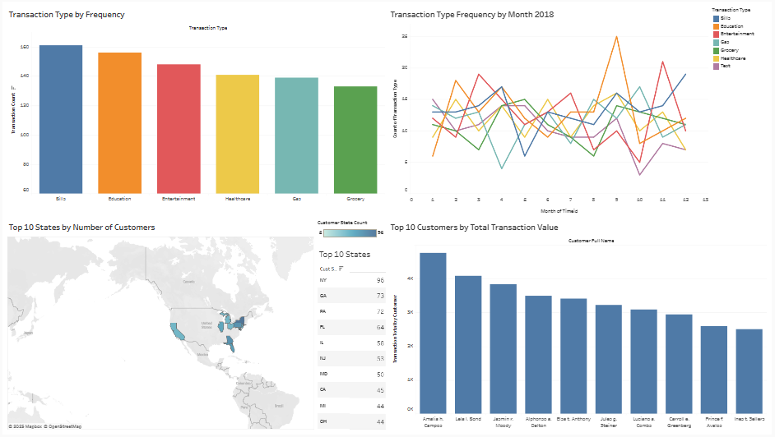
Tableau Visualization

